Slide 1
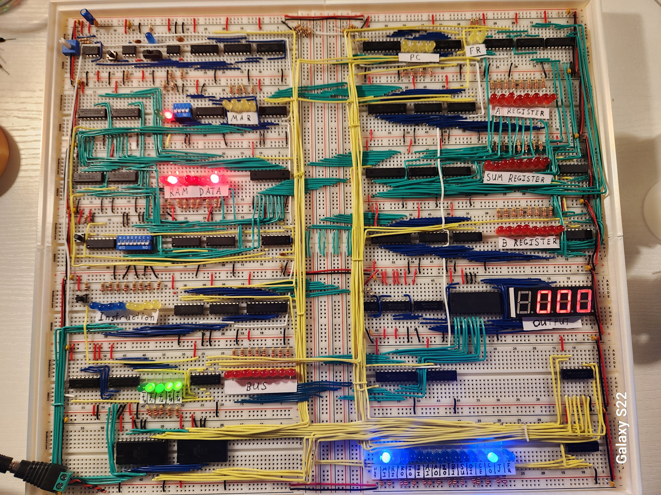
8-Bit breadboard CPU

Slide 2
The Clock Module
The clock module uses three 555 timers in astable, bistable, and monostable configurations to create the main clock for the computer. The variable resistor is used to control the speed in astable mode, the switch is used to switch between astable and monostable, and the button is used to manually pulse the clock when it is in monostable mode.

Slide 3

The RAM Module
The RAM module is comprised of two separate parts: the memory address register (MAR), and the random-access memory itself. The 74ls189 chips each store 16 4-bit words. Two of these are combined to give a total of 16 bytes of memory. This is the maximum that is addressable because the MAR is only 4 bits wide.
The RAM module has two modes: manual and automatic. In manual mode, DIP switches are used to enter the address and data. Once both are set, the button can be pressed to write the data to that address. In automatic mode, the CPU has full control over the RAM and can read and write as needed.

Slide 4
The Instruction Register
The instruction register is used to hold the opcode and operand for the current instruction being executed. The top four bits are the opcode and are decoded in the control logic. The bottom four bits are connected to the bus and represent the operand of the instruction.

Slide 5


The Bus
The bus is used to facilitate communication between each component. Every part is connected through a set of tri-state buffers that are controlled by the CPU to make sure multiple components aren’t talking at the same time.
The control logic uses two EEPROMs to set the control word depending on which instruction is set, which step the computer is on, and whether the flags in the flags register are set.
The Control Logic

Slide 6

The Program Counter and Flags Register
The program counter is used to tell the computer which address to look for the next instruction to execute. The CPU can control when to clock the counter and when to read a value into the counter, which is essentially jumping to another part of the program.
The flags register is used for conditional branching. The left bit is the carry flag, and the right bit is the zero flag. The flags are set by the ALU if either condition is met.

Slide 7
The ALU
The ALU has two registers which are either added or subtracted depending on the control signal. The sum is calculated asynchronously and stored in the sum register.

Slide 8
The Output Register
The output register uses an EEPROM to send the correct signals to the display. The seven segment displays use multiplexing to quickly switch between each of the four displays, giving the illusion that there is a four-digit number being displayed.

Slide 9
The Control Word
The control word represents the signals that control each micro-instruction. Each assembly instruction is composed of up to 6 steps of micro-instructions.

Slide 10
